Slide 1

MSc in Social Science Research Methods
Developing core research skills
Semester 2 - Week 1
Working with your Supervisors
Dirk Lindebaum

Slide 2
Aims of this session
Review your current expectations of being supervised in learning to conduct research
Outline arrangements and the rationale for them at Cardiff University
Explore how you can help to maximize the potential of the student-supervisor relationship for meeting your priority learning needs

Slide 3
1. Current expectations of being supervised

Slide 4
Supervision prospects
If you have been accepted to study for
The SSRM programme for an MSc degree, you are allocated a supervisor when your dissertation proposal has been sent to your School
A PhD degree, you may already have supervisors – the lead supervisor normally supervises your SSRM dissertation

Slide 5
What’s the use of being supervised?
Share in your group:
Which would you prefer (and why):
To be allowed to do your dissertation (and PhD) project on your own?
Or to be required to do your research project(s) under academic supervision?

Slide 6
What can you learn from a doing a supervised dissertation (or PhD) project?
In your group:
Write down five ways in which being supervised in doing your dissertation or PhD project could help you learn about research and learn how to do it
Why could each of these ways help?
What would you have to contribute to make them work?

Slide 7
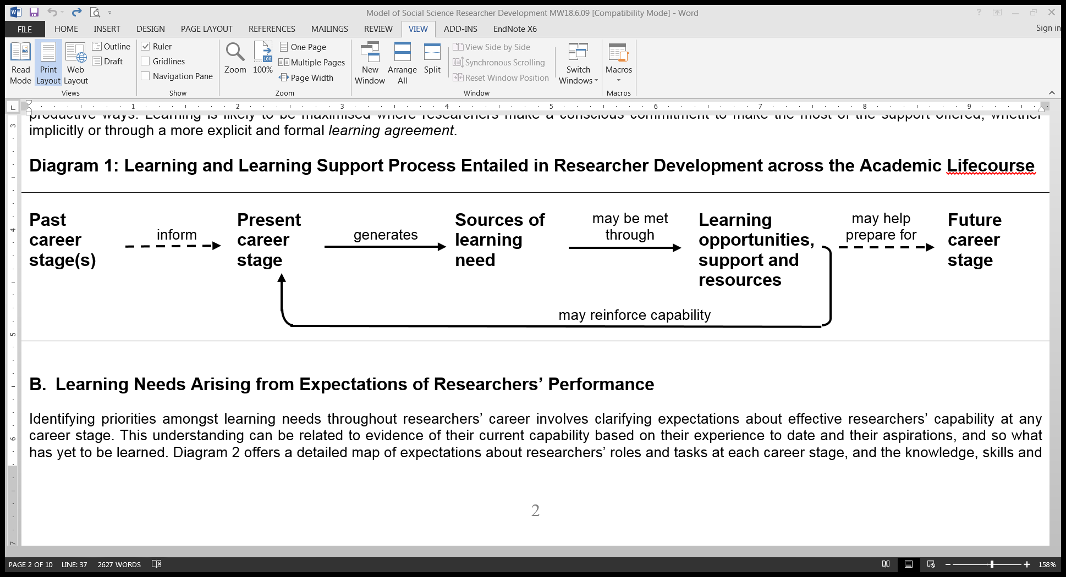
Modelling your development process
Sources of your learning needs arise from your learning goals, career aspirations, and expectations of
What you should know about (knowledge)
What you should know how to do (skills)
What values you should have (attitudes)
at your career stage to carry out research tasks effectively and continue developing your expertise

Slide 8
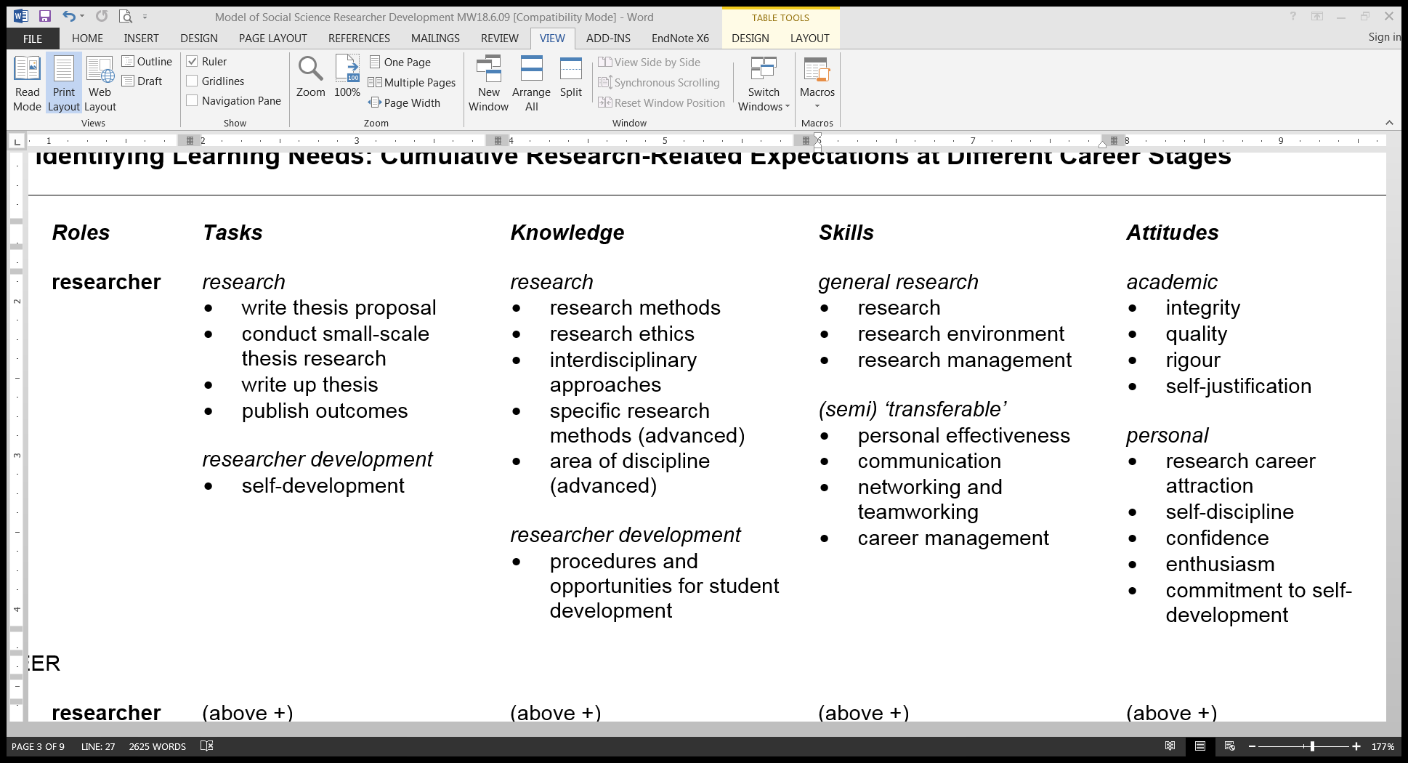
Common expectations of PG researchers
How can you learn how to do all these tasks?

Slide 9
A vital opportunity for development
A supervised dissertation (or PhD) project offers many individual learning opportunities, support and resources
And much, much more…

Slide 10
A vital opportunity for development
The combination of these opportunities offers an integrated experience of guided learning
about a substantive topic, research methodology, and the supervision process
how to do research and develop yourself as a researcher

Slide 11
What do you expect, how do you know?
Reflect on your previous experiences of working under guidance, and any experiences of being supervised here…
Share in your group:
What do you expect the experience will be like of learning through a supervised process of planning, conducting, and writing-up your dissertation project?
What official and other sources have informed your expectations?

Slide 12
2. Arrangements – what and why

Slide 13
Information: SSRM programme
Student handbook for SSRM and other
taught masters programmes in the School of Social Sciences
outlines your supervisor’s responsibilities (handout p1)
Associated student handbook for dissertation
details what your and the supervisor’s responsibilities include (handout p1-2)
includes a log of your supervision meetings – you keep it, supervisor signs after each meeting, you submit it with the dissertation (handout p3)

Slide 14
Information: SSRM programme
Have you received one or both of these handbooks?
Student handbook for SSRM and other
taught masters programmes in the School of Social Sciences
outlines your supervisor’s responsibilities (handout p1)
Associated student handbook for dissertation
details what your and the supervisor’s responsibilities include (handout p1-2)
includes a log of your supervision meetings – you keep it, supervisor signs after each meeting, you submit it with the dissertation (handout p3)
If so, have you read them?
You can download these handbooks from Learning Central (SSRM webpages)

Slide 15
What must go right? What could go wrong?
Share in your group:
For each student responsibility listed (handout p1-3)
How could it help you to do your dissertation project (and pass) well?
What (if any) potential problems is it designed to help prevent or resolve?

Slide 16
Our expectations about the limits of supervisors’ responsibilities (handout p2)
Reminder: how do students’ support needs differ from their learning needs?
Supervisors are expected to be accessible to students at reasonable times. However, it is important to understand that they have a wide range of other duties; it is therefore important that you agree a schedule of meetings. The actual number and frequency of meetings is not stipulated, but should be a matter of negotiation, taking into account the support needs of the student.
What support needs might a student unreasonably have?

Slide 17
Our expectations about the limits of supervisors’ responsibilities (handout p2)
Your supervisor is the key source of advice on your dissertation. He/she will advise you whether your dissertation is of sufficient quality to be examined. However, your dissertation is a piece of work that you carry out. Accordingly, the ultimate responsibility for the content and quality of your dissertation is your own.
Supervisors can help, but it’s your dissertation!

Slide 18
What must go right? What could go wrong?
Look again at the list of students’ responsibilities (handout p1-3)
What’s missing from the list – could additional responsibilities help?
e.g. taking responsibility for learning how to maximize your learning?

Slide 19
Our expectations of our supervisors (handout p2)
Share in your group:
For each supervisor responsibility –
How could it help supervisors to help you to do the dissertation project (and pass) well?
What (if any) potential problems is it designed to help prevent or resolve?

Slide 20
Looking ahead – if you are accepted to study for a PhD degree…

Slide 21
Information about PhD supervision: Cardiff University
Postgraduate research:
Code of Practice for research degrees (e.g. PhD) (http://learning.cf.ac.uk/quality/pgr/code/)
Includes:
What research students are entitled to expect (handout p4)
Key information for supervisors (p5)
Supervisors’ responsibilities (p6)
Research students’ responsibilities (p7)

Slide 22
3. Maximizing learning through the student-supervisor relationship

Slide 23
A low risk (not no risk), high gain relationship
Learning by doing a supervised project depends on developing and sustaining a productive professional relationship
Very small risk of student-supervisor relationships going wrong
Risk minimized by transparent regulations, progress monitoring (e.g. dissertation log), procedures for voicing concerns
Success record at Cardiff University is evidence of low risk, high gain for students

Slide 24
Three characteristics of the student-supervisor professional relationship
Always evolving (a ‘journey’)
You and your supervisor become more familiar with each other’s existing knowledge, experience, expectations, working style, reliability, worries, intellectual passions
You gradually acquire more specific knowledge about your project
Work on the project continually changes from getting started to submitting report

Slide 25
Three characteristics of the student-supervisor professional relationship
Asymmetrical (students have most to learn)
Supervisors are likely to have learned from their own student experience of doing supervised research, plus more recent experience of supervising other students
Supervisors are likely to know more about relevant literature, strengths and weaknesses of methods
You are likely to be less sure about pacing work, less aware of potential problems

Slide 26
Three characteristics of the student-supervisor professional relationship
Mutual dependence (each needs the other for the supervised project to be successful)
You depend on your supervisor for sound guidance, timely feedback on the project, advice on publishing, careers, networking (you may also be accountable to a funder)
Your supervisor depends on you to do the work well, honestly, on time, and learn from feedback (supervisors are accountable for timely progress, quality)

Slide 27
Evolution, asymmetry, mutual dependence – so what?
In your group, discuss:
How can you help to make the student-supervisor relationship work from start to finish, given these characteristics?
List three general points of advice for students

Slide 28
Preparation for Week 2: School ethics approval procedure
Individually, find out for yourself what your School’s ethics approval process is that covers all masters dissertation research
Locate and access the relevant information (e.g. on Learning Central)
Read and print out the standard ethics approval form (for research where you collect data from people, involving low risk to them, yourself and others affected
Bring this form to the workshop!

